Slide 1
10-5 CHECKSUM
The last error detection method we discuss here is called the checksum. The checksum is used in the Internet by several protocols although not at the data link layer.
Topics discussed in this section:
Idea One’s Complement Internet Checksum
10.

Slide 2
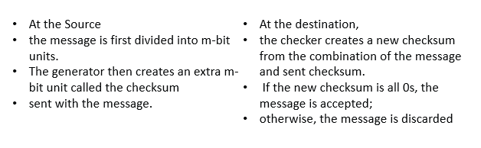

Slide 3
Example 1:
Suppose our data is a list of five 4-bit numbers that we want to send to a destination.
In addition to sending these numbers, we send the sum of the numbers.
For example, if the set of numbers is (7, 11, 12, 0, 6),
we send (7, 11, 12, 0, 6, 36), where 36 is the sum of the original numbers.
0111 1011 1100 0000 0110 0100
10
0110 = 6 CHECKSUM 1’S COMPLEMENT 1001 = 9
10.

Slide 4
Example 2:
We can make the job of the receiver easier if we send the negative (complement) of the sum, called the checksum. In this case, we send (7, 11, 12, 0, 6, −36).
The receiver can add all the numbers received (including the checksum).
If the result is 0, it assumes no error; otherwise, there is an error.
10.

Slide 5
How can we represent the number 21 in one’s complement arithmetic using only four bits?
Solution
The number 21 in binary is 10101 (it needs five bits). We can wrap the leftmost bit and add it to the four rightmost bits. We have (0101 + 1) = 0110 or 6.
0101
1
10.

Slide 6
Example 10.21
How can we represent the number −6 in one’s complement arithmetic using only four bits?
Solution
In one’s complement arithmetic, the negative or complement of a number is found by inverting all bits. Positive 6 is 0110; negative 6 is 1001. If we consider only unsigned numbers, this is 9. In other words, the complement of 6 is 9. Another way to find the complement of a number in one’s complement arithmetic is to subtract the number from 2^{n} − 1 (16 − 1 in this case).
10.

Slide 7
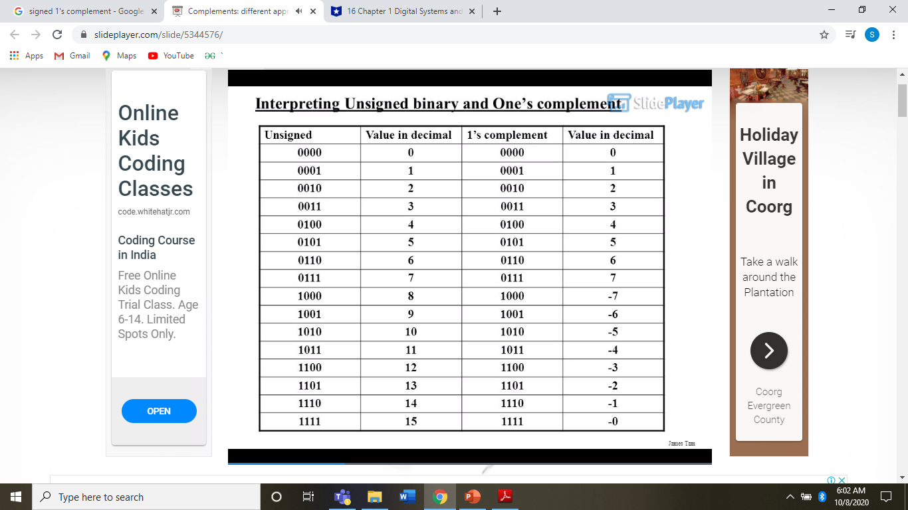

Slide 8
One’s Complement Addition
Example
In the previous example, the decimal number 36 in binary is (100100)2.
To change it to a 4-bit number we add the extra leftmost bit to the right four bits as shown below.
0100
10
0110
Instead of sending 36 as the sum, we can send 6 as the sum
(7, 11, 12, 0, 6, 6).
The receiver can add the first five numbers in one’s complement arithmetic. If the result is 6, the numbers are accepted; otherwise, they are rejected.

Slide 9
Checksum
We can make the job of the receiver easier if we send the complement of the sum, called the checksum.
In one’s complement arithmetic,
the complement of a number is found by completing all bits (changing all 1s to 0s and all 0s to 1s).
This is the same as subtracting the number from 2m − 1.
In one’s complement arithmetic,
we have two 0s: one positive and one negative, which are complements of each other.
The positive zero has all m bits set to 0;
the negative zero has all bits set to 1 (it is 2m − 1).
If we add a number with its complement, we get a negative zero (a number with all bits set to 1).
When the receiver adds all five numbers (including the checksum), it gets a negative zero.
The receiver can complement the result again to get a positive zero.

Slide 10
Example
In the Previous Example we have seen
The result is 36.
However, 36 cannot be expressed in 4 bits.
The extra two bits are wrapped and added with the sum to create the wrapped sum value 6.
The sum is then complemented, resulting in the checksum value 9 (15 − 6 = 9).
10.

Slide 11
Example 10.22 (continued)
The receiver follows the same procedure as the sender. It adds all data items (including the checksum); the result is 45. The sum is wrapped and becomes 15. The wrapped sum is complemented and becomes 0. Since the value of the checksum is 0, this means that the data is not corrupted. The receiver drops the checksum and keeps the other data items. If the checksum is not zero, the entire packet is dropped.
10.

Slide 12
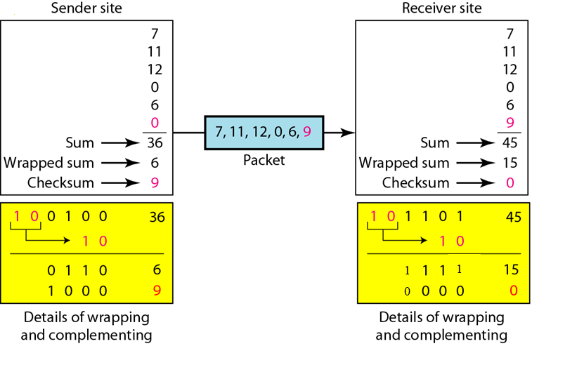
Figure 10.24 Example 10.22
10.

Slide 13
Internet Checksum Traditionally, the Internet has used a 16-bit checksum. The sender and the receiver follow these steps

Slide 14
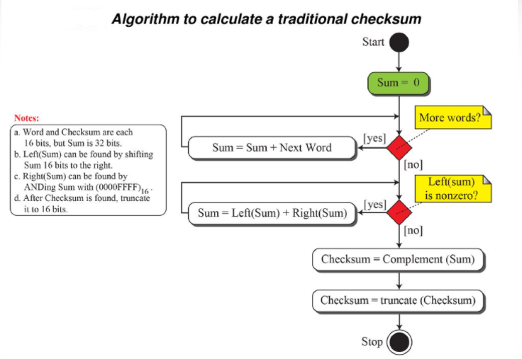

Slide 15
1001100111001100
0110011000110011
10011100111001100
11

Slide 16
Example 10.23
Let us calculate the checksum for a text of 8 characters (“Forouzan”). The text needs to be divided into 2-byte (16-bit) words. We use ASCII (see Appendix A) to change each byte to a 2-digit hexadecimal number. For example, F is represented as 0x46 and o is represented as 0x6F. Figure 10.25 shows how the checksum is calculated at the sender and receiver sites. In part a of the figure, the value of partial sum for the first column is 0x36. We keep the rightmost digit (6) and insert the leftmost digit (3) as the carry in the second column. The process is repeated for each column. Note that if there is any corruption, the checksum recalculated by the receiver is not all 0s.
10.

Slide 17
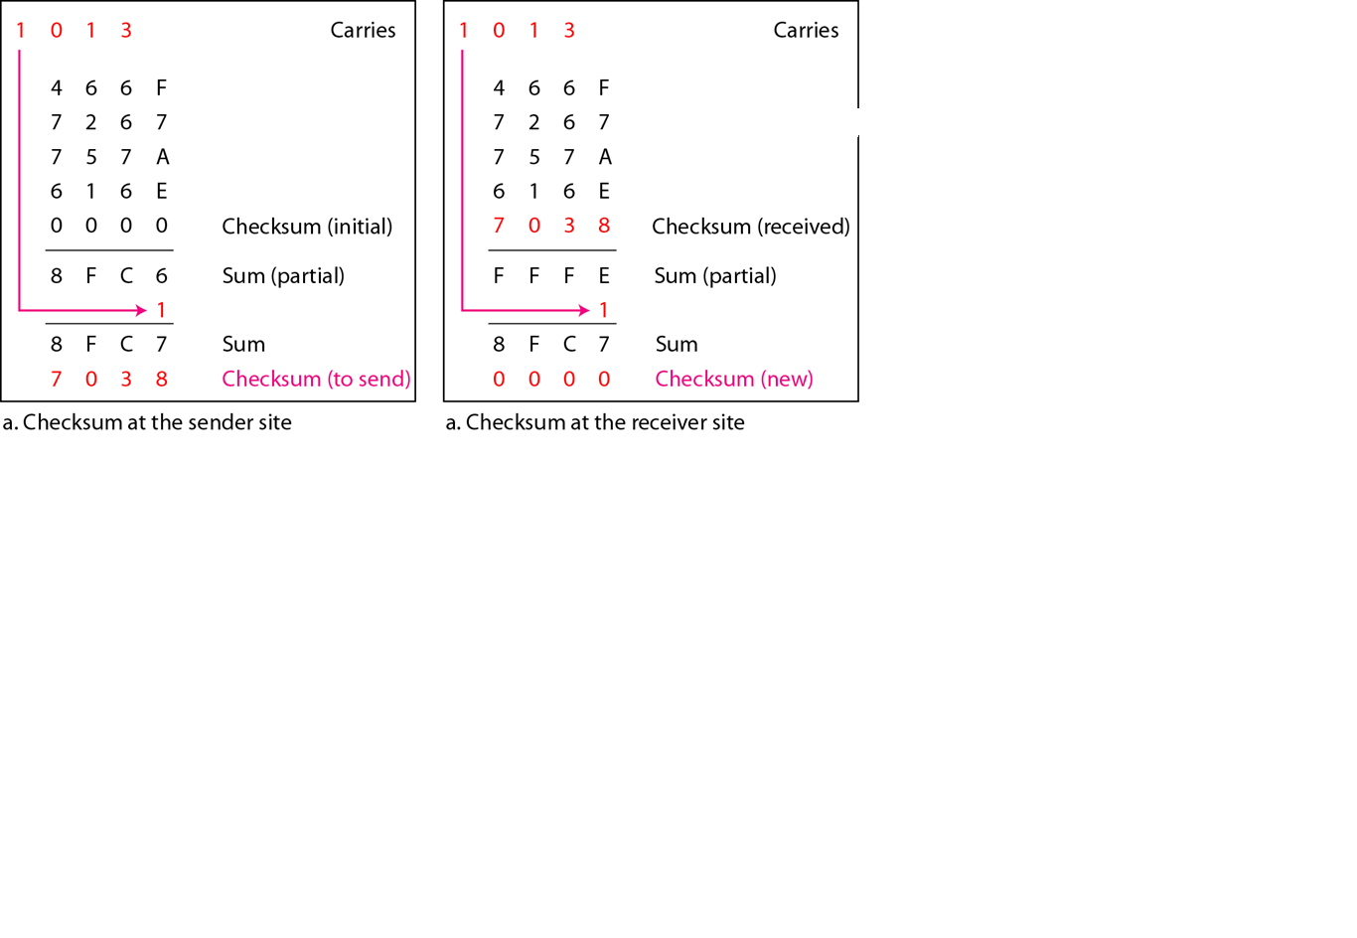
Figure 10.25 Example 10.23
10.

Slide 18
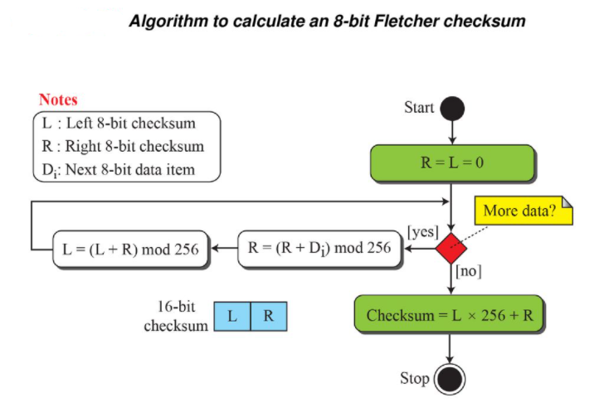
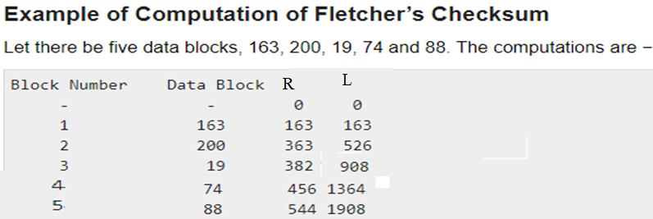

Slide 19
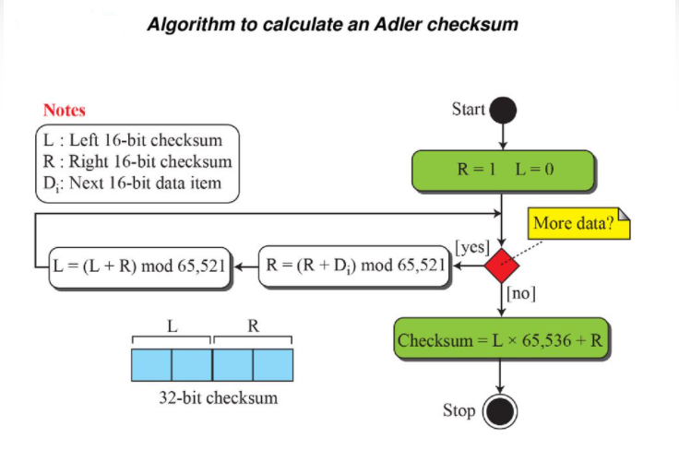

Slide 20
